Slide 1

Developing Modeling and Analysis Tools for Apricot Language
The Progress, Expectation and Future

Slide 2
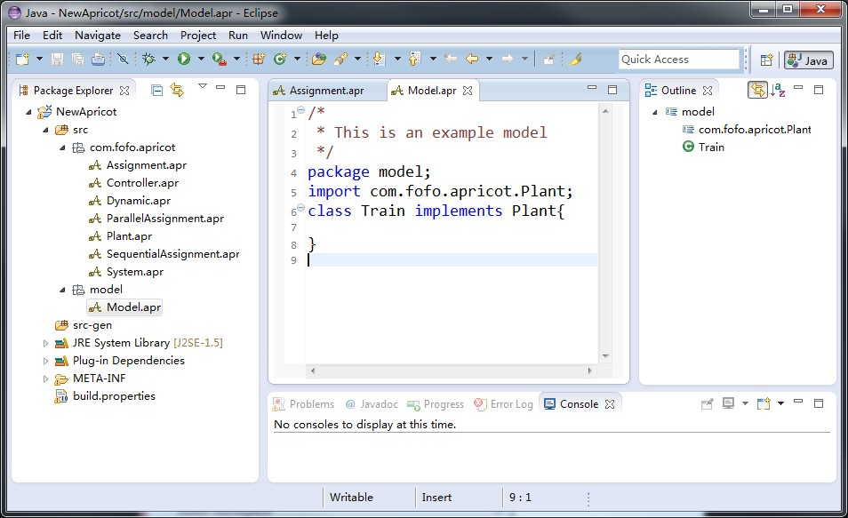
Progress
A Prototype Modeling Tool is Available：
Apricot Web-Site:
www.apricotresearch.com
Eclipse plug-in for Apricot:
www.fanghuixing.com/XtextApricot

Slide 3
Expectation
Implement Type System in XtextApricot
Benjamin C. Pierce, Types and Programming Languages, The MIT Press Cambridge, Massachusetts London, England, 2002.
Formal Verification on Hybrid Systems Constructing by Apricot Language
Static Analysis （PATRICK COUSOT）

Slide 4
Future of Apricot
Simulink/Stateflow
Simulation
Animation
Verification
knowledge discovery
Feedback
Advancement
Data mining
Static Analysis
Computer Vision
Machine Learning
Computer Graphics

